Slide 1


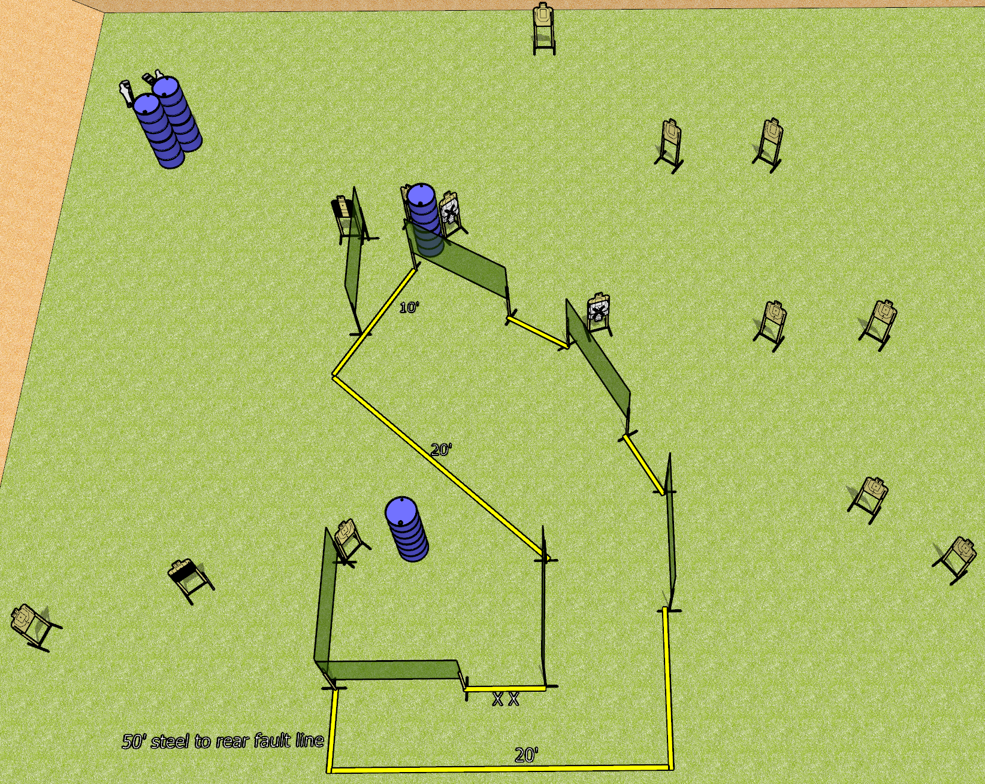
 | Dothan Gun Club – USPSA Match Going Over There Course Designer : Drew Coleman
Round Count 30 rounds 14 USPSA 2 mini poppers
Equipment List 13 wall feet 1 50%, 1 tux, 1 right diag, 13 targets (11 + 2 NS)

Slide 2
Going Over There
Written Stage Briefing
Scoring: Comstock
Targets: 14 USPSA, 2 poppers
Rounds: 30
Handgun start position: toes on X’s, wrists below belt. Handgun is loaded and holstered.
PCC start position: toes on X’s, stock on belt. Carbine is loaded.
Stage Procedure: on the audible start signal, engage targets as they become available from within the shooting area.

